Slide 1
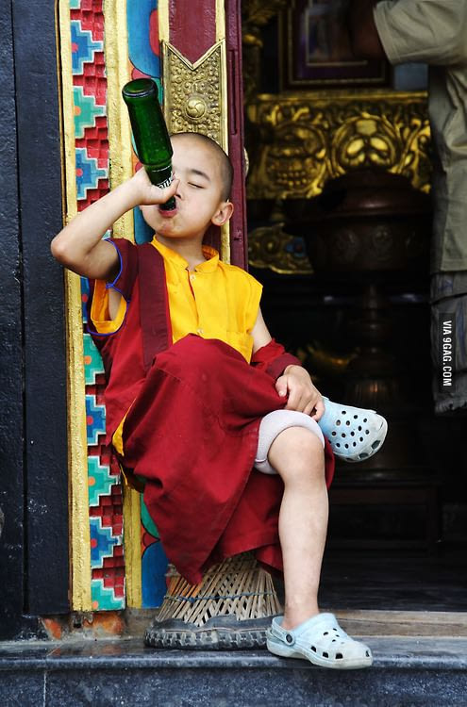
Cultural Diffusion

Slide 2
Definition
A process in which one cultural trait, material object, idea, or behavior pattern is spread from one society to another.
Can be intentional or unintentional
Can have both positive and negative consequences

Slide 3
Kinds of Diffusion
1. Direct Diffusion- direct contact between two cultures i.e trade, intermarriage, warfare.
2. Forced Diffusion/Expansion Diffusion- one culture defeats another and forces its beliefs and customs on the conquered group.
3. Indirect Diffusion - culture spread through middleman or another culture.

Slide 4
Partner Work
Identify an example of cultural diffusion that has occurred to you with your partner.
Identify which kind of diffusion is it? (Direct, Forced, or Indirect)
Reverse roles of speaker and listener.
Continue to do partner work until told to stop.

Slide 5
Diffusion of Culture
“Little ____” “________towns”
Sports
Music
Language
Foods
Religion
Clothing
Customs

Slide 6
Other Kinds of Diffusion
Technology
Economies
Governments
Theories/Ideas

Slide 7
Diffusion Quiz
Where did these come from?
False teeth (8C BC)
Etruria
Gears (4C BC)
China
Paper (2C BC)
China
Vending machine (1C AD)
Alexandria
Wheelbarrow (2C AD)
China

Slide 8
Diffusion Quiz
Where did these come from?
Toilet paper (6C AD)
China
Mechanical clock (8C AD)
China
Zero (9C AD)
India
Revolver (16C AD)
Germany
Refrigerator (18C AD)
Scotland

Slide 9
Diffusion Quiz
Where did these come from?
Polyester (20C AD)
Britain
Pocket calculator (20C AD)
Japan
World Wide Web (20C AD)
Britain
First Web Browser--Mosaic (20C AD)
US
Refrigerator (18C AD)
Scotland

Slide 10
Looking for Signs of Cultural Diffusion
Symbols (yin/yang)
Materials (teak)
Foods (pineapples)
Religions (Hinduism)
Family or Gender Roles (woman wearing a burqa)
Values (red is a lucky color)
Language (El Charro Restaurant)
Possessions (Pocky candy)

